Slide 1
GPS Jamming Detection
Team Members
Ben Wilson
Chi Wong
Devin Lorenzen
Edward Sayers
Hanjae Noh
Sponsors
Vernon Jones
Rocky Chase
Eric Krause
Faculty Advisor
Dr. Fu Li

Slide 2
Who Is Jamming?
Taxi Drivers
Use GPS Jammers In order to report false locations in order to obtain more fares.
Truck Drivers
Use GPS Jammers to hide their driving times.
Criminals
Use GPS jammers to hide the location of a stolen vehicle.

Slide 3
What types of jammers are there?
CW jammers
Narrow band single frequency use to corrupt data.
Pulse
Quick pulses to help mask the use of GPS and Prevent signal lock.
Chirp
CW that changes frequency over time.

Slide 4
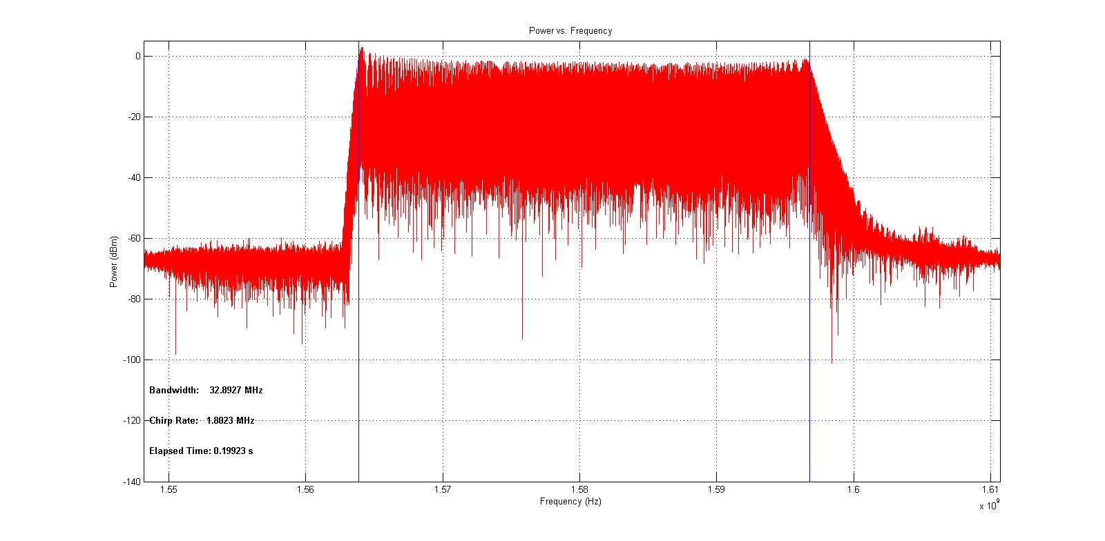
Chirp Jamming
Occupies the L1 Band (1575.42 MHZ)
Outputs a signal Power of >-65dBm

Slide 5
Project outline
Marketing Requirement
-must: GPS Jamming signal is present
-should:Be implemented on a FPGA
Design specification
-Must input IQ Data
-Must Detect one method of jamming
Notes:
Note: If multi-frequency jammers transmitted signals characterized by the same sweep period in each frequency band. This considers to be that a single local oscillator is used for the generation of all the signals.
5

Slide 6
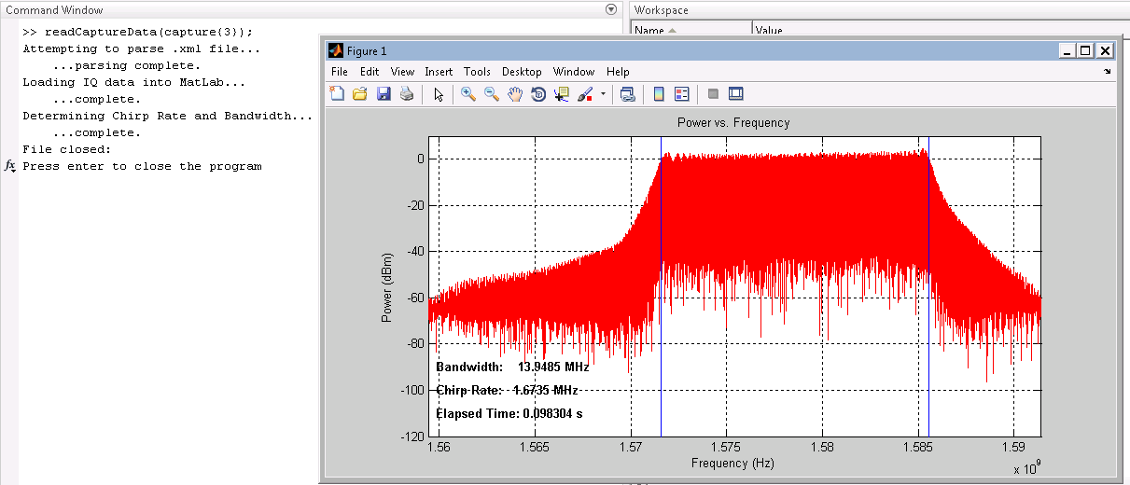
Jammer Simulations in MATLAB
Metadata is read from the XML file
IQ data is read into a matrix
Data is transformed and plotted in frequency domain

Slide 7
Detector Algorithm Design
Increasing the RBW by using smaller FFTs allow the user to see single peak frequencies
Detector is triggered when the maximum value of the power spectrum crossed some threshold
Once triggered, peak frequencies can be tracked over time to measure chirp rate and bandwidth

Slide 8
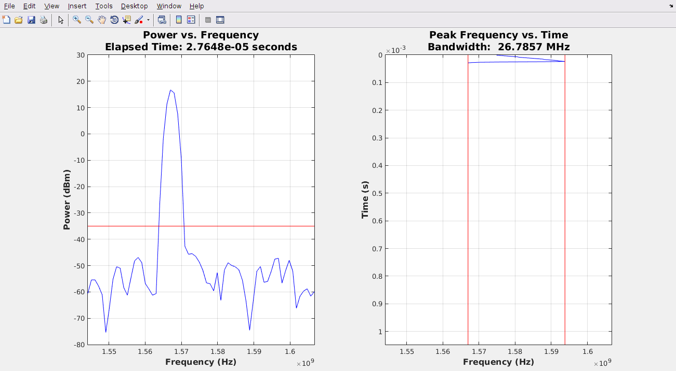
Jammer 3 Detection Demo 1/2

Slide 9
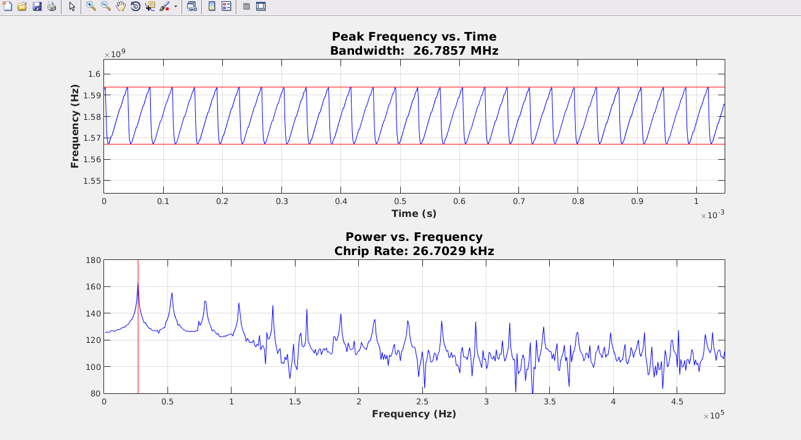
Jammer 3 Detection Demo 2/2

Slide 10
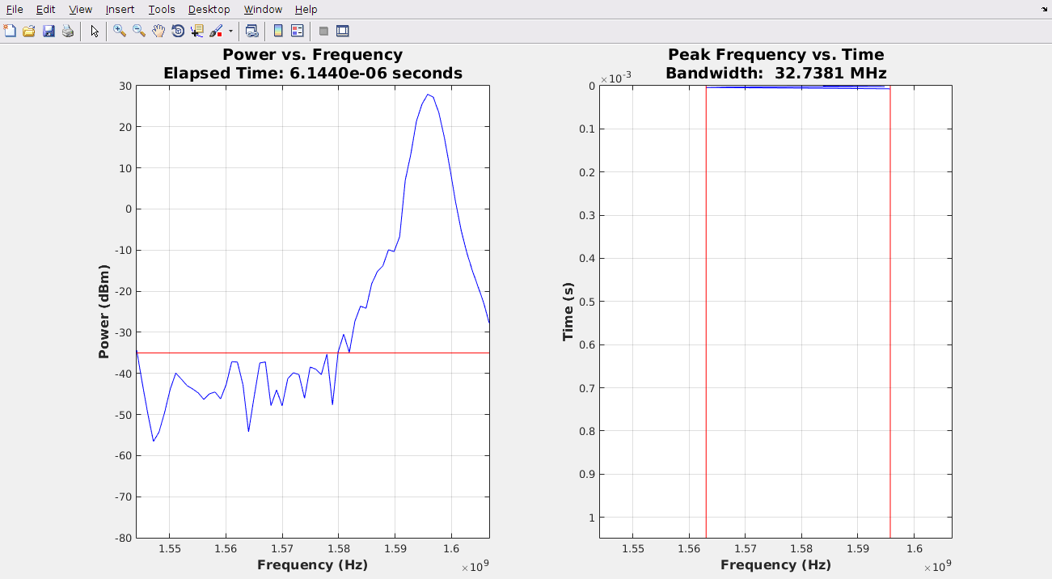
Jammer 4 Detection Demo 1/2

Slide 11
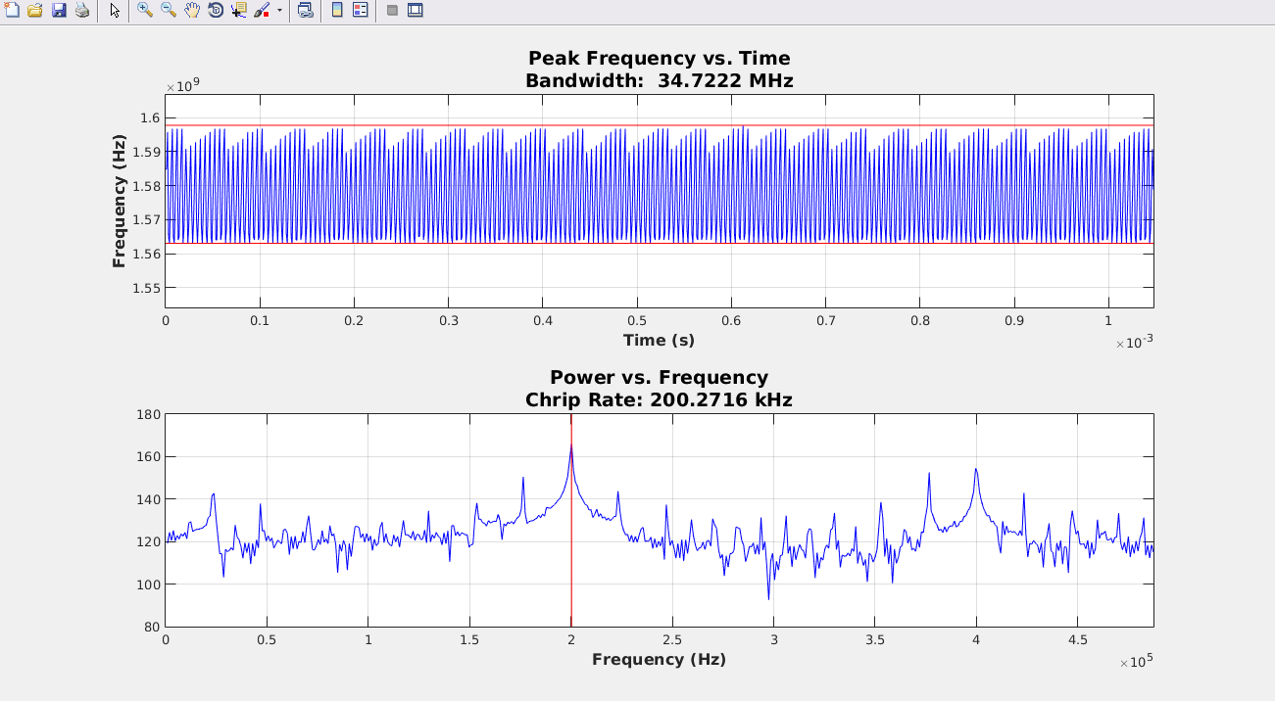
Jammer 4 Detection Demo 2/2

Slide 12
Hardware Design
Vivado 2014.4 with SDK
Single ARM core processing system
GPIO in PL for LEDs and switches
DMA controller to feed data to FFT
FFT implemented in PL

Slide 13
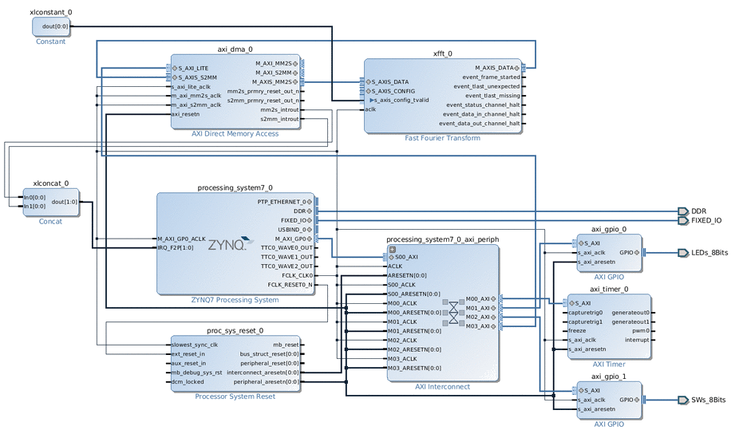
Hardware Design
Notes:
FFT Implemented in hardware but not in software
Single ARM core
GPIO support for switches and LEDs

Slide 14
Client Program
Written in Python
Retrieves metadata from XML
Send metadata and 64 IQ pairs

Slide 15
FPGA Software
FreeRTOS v7.0.2
lwip v1.4.0
Based on lwip demo (XAPP1026)
Allows TCP connections from client program

Slide 16
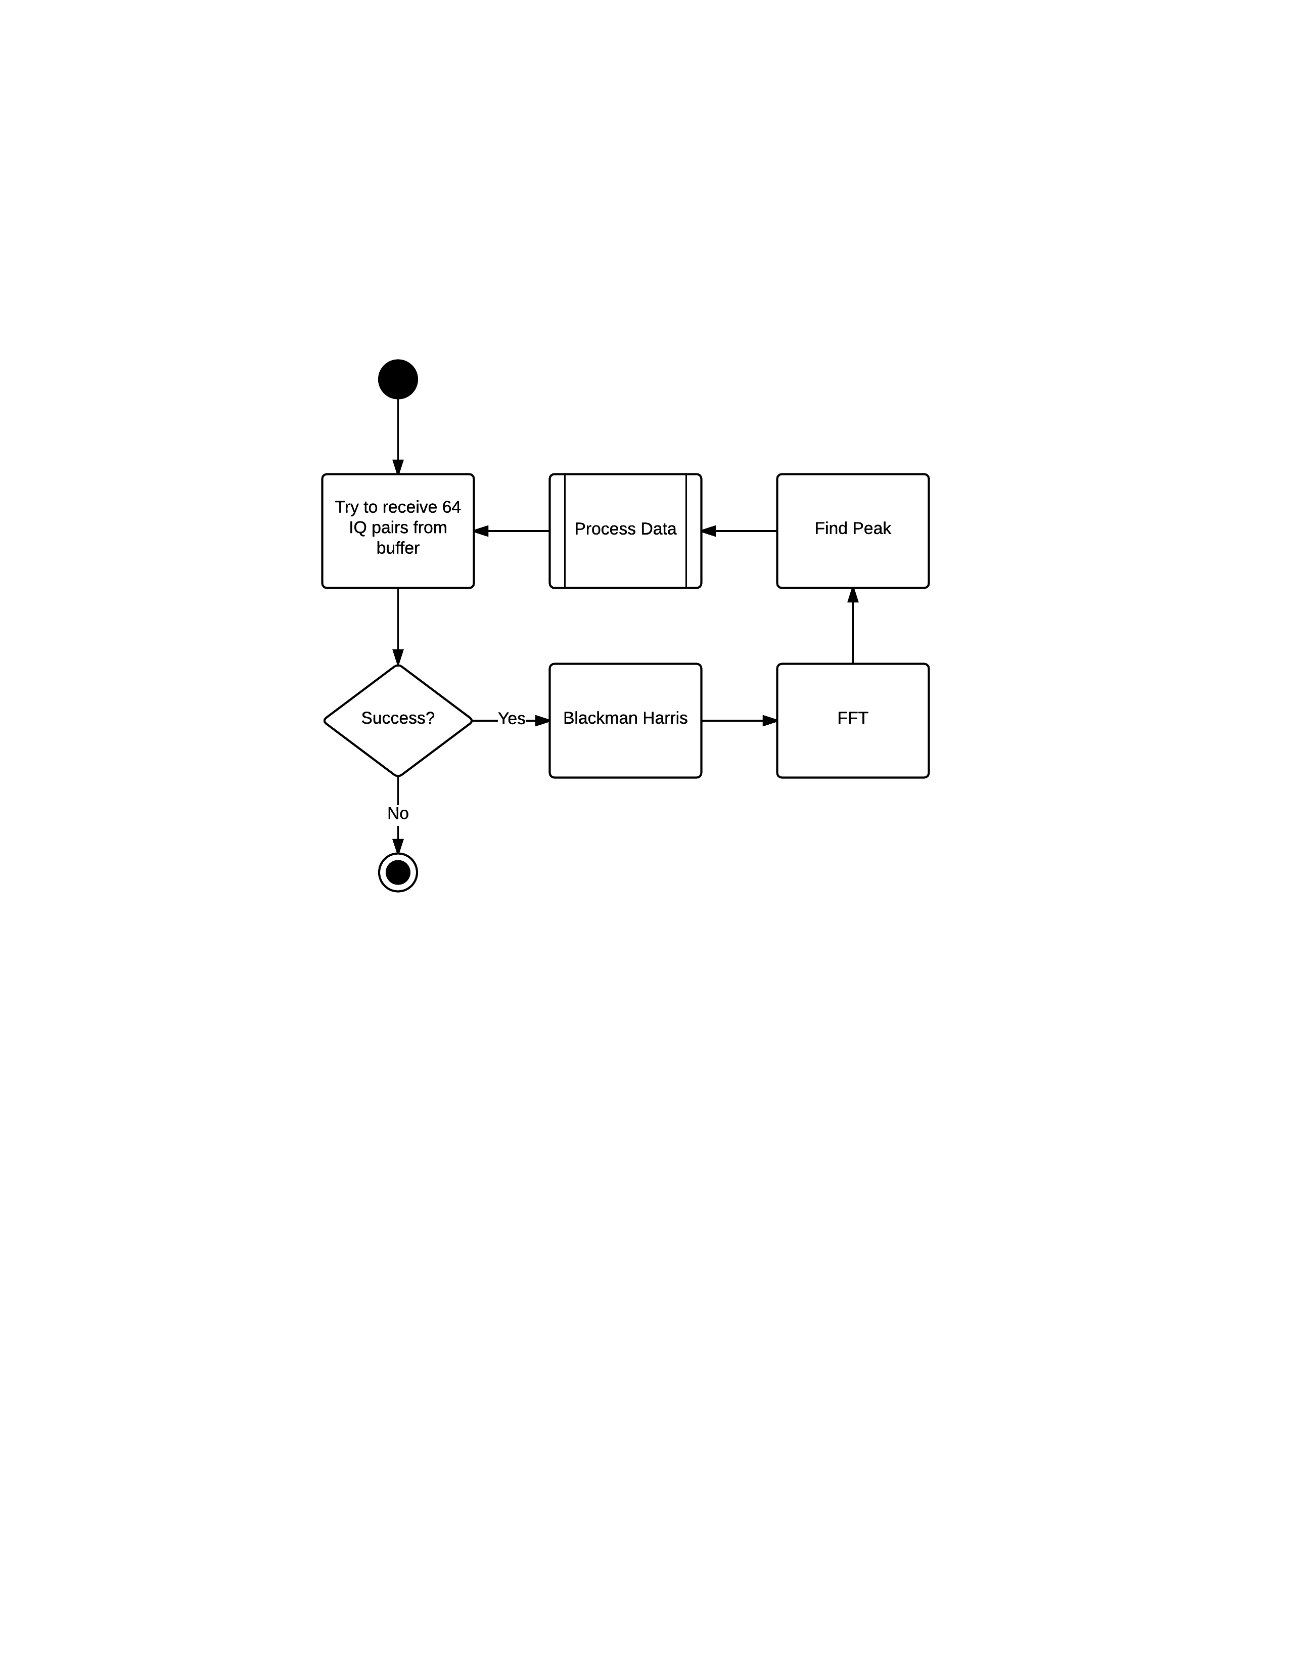
Main Program Loop

Slide 17
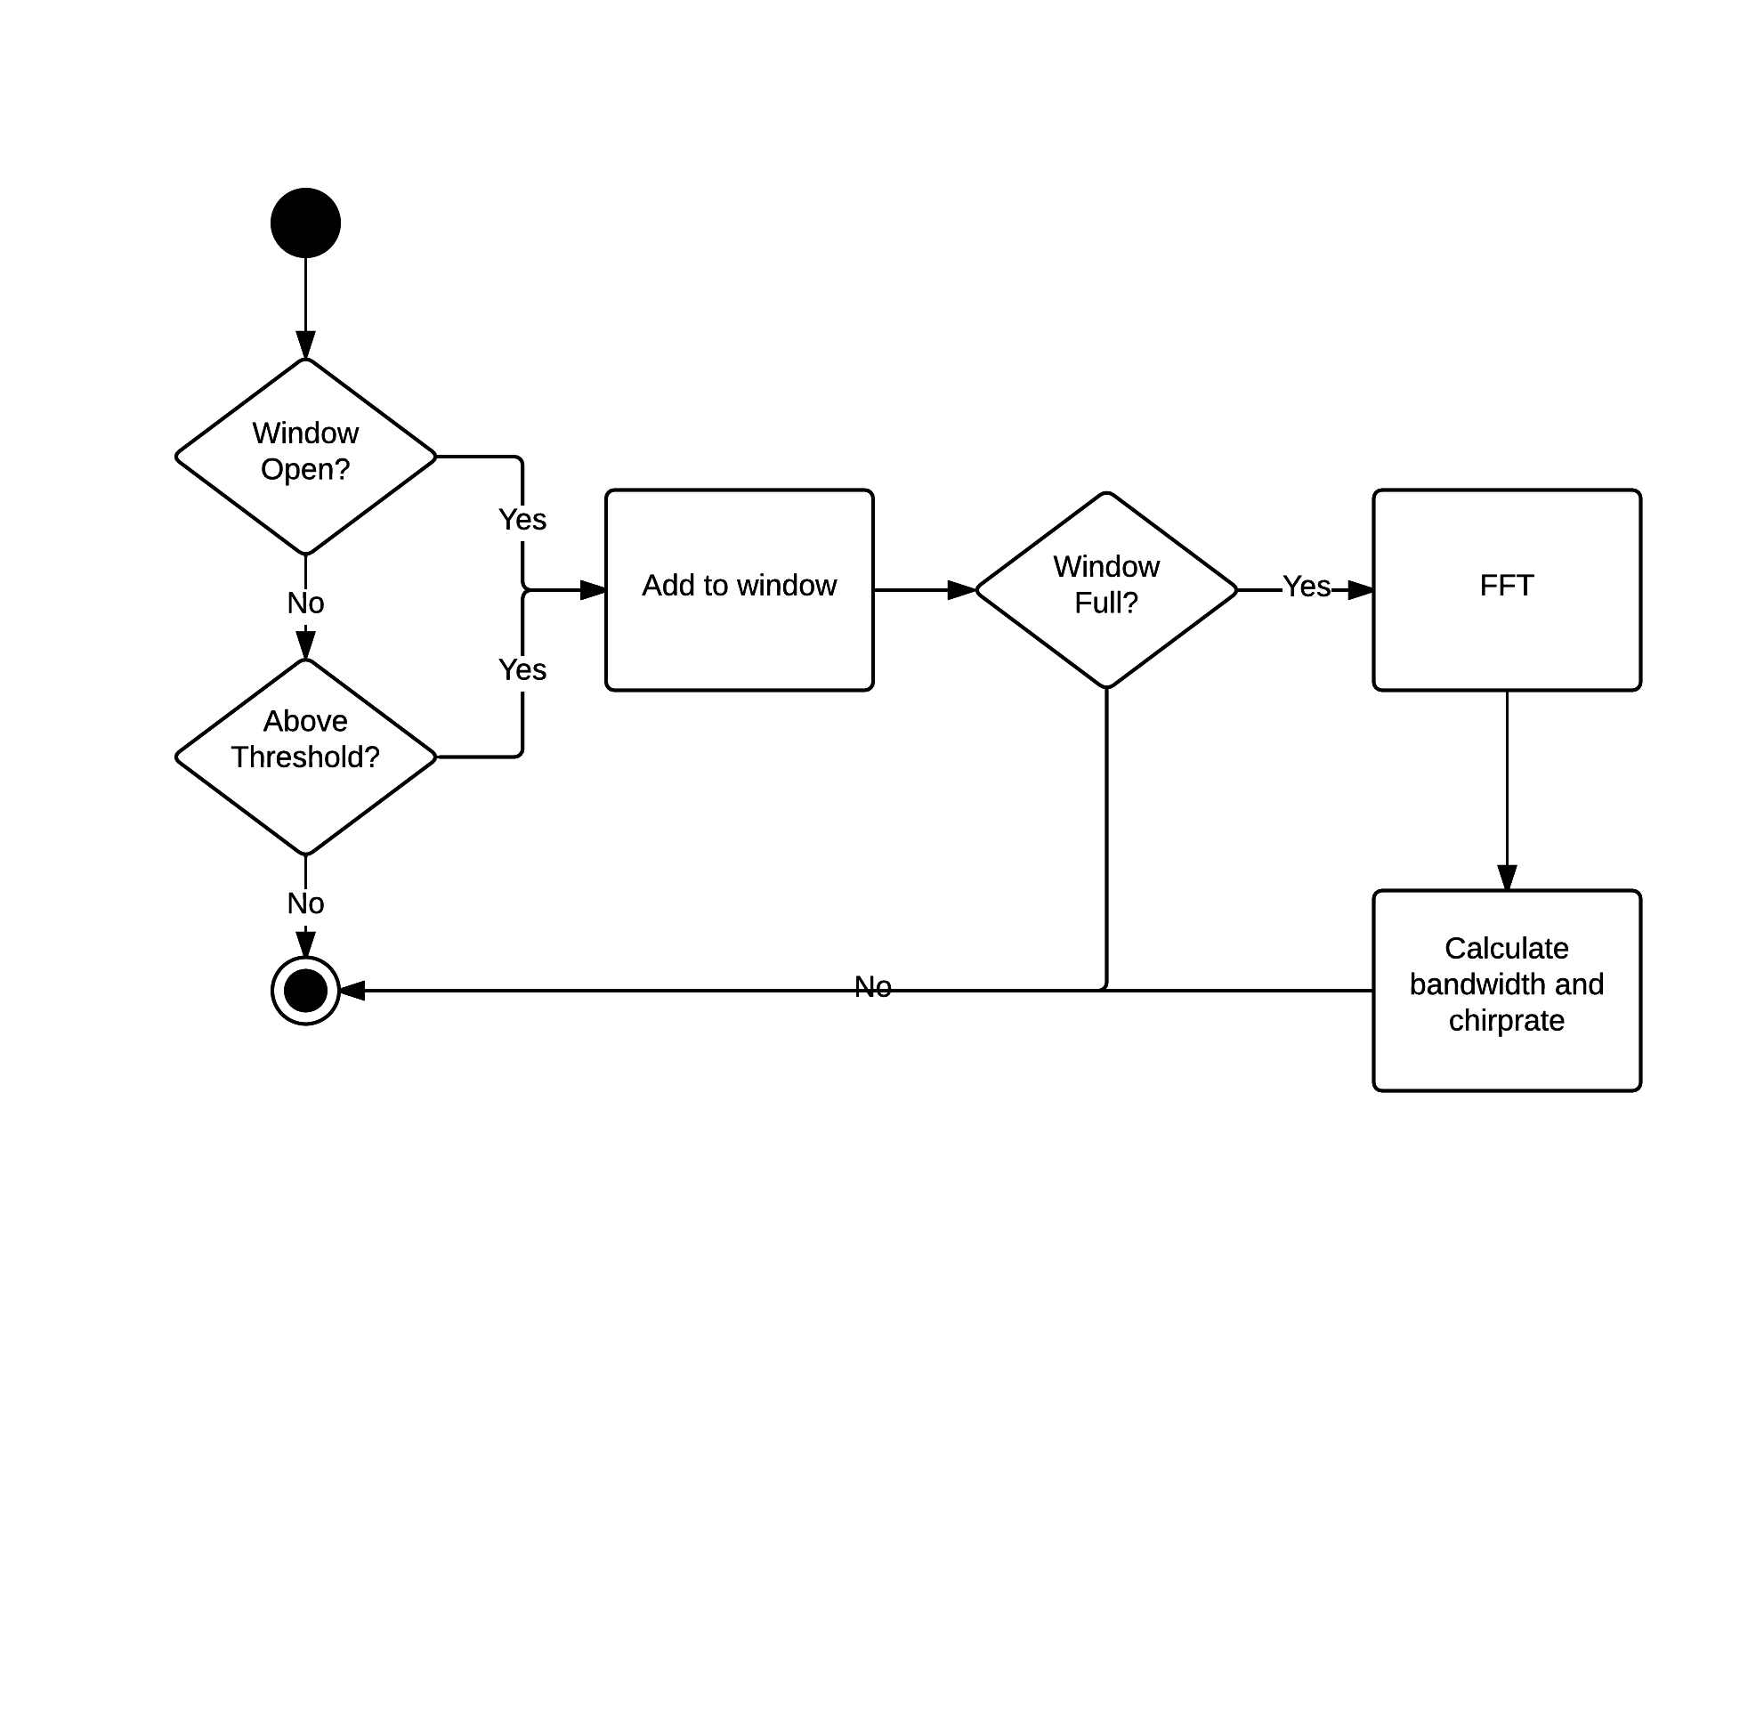
Window Processing

Slide 18
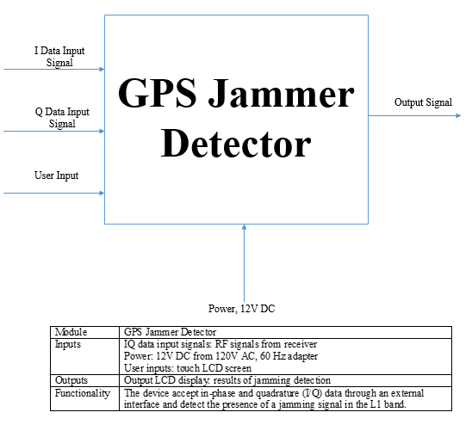
GPS Jammer Detector

Slide 19
Test Plan
The test scope, focus areas and objectives
Detail the approach and strategy for testing of the solution
Explain the execution, results documentation and review of the testing
Any risks, issues, assumptions and test dependencies
The test schedule and major milestones

Slide 20
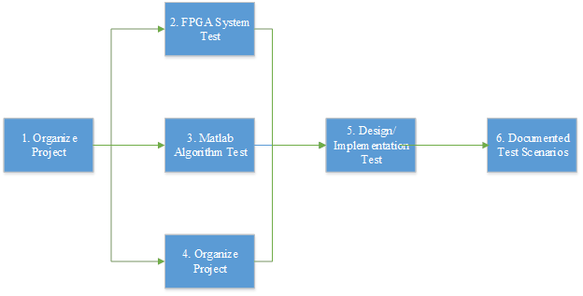
Testing Process

Slide 21
Types of Testing Performed
Input (read files)
Output (write/store files)
System Performance
Algorithm Verification

Slide 22
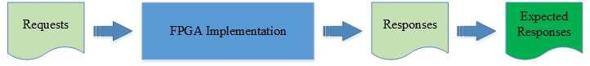
Test Approach
Generate test inputs (requests) for testing of FPGA implementation
White box testing
Black box testing

Slide 23
Items Not Tested
FPGA connectivity with the third party system (Receiver) was not tested
Why
the connectivity could not be established due to some technical limitations. This can be verified during UAT (User Acceptance Testing) where the connectivity is available or can be established.

Slide 24
Testing Performed on Matlab
Set threshold dBm
Attenuate original signal to noise floor, stepping by small number(user input)
Compare maximum power of attenuated signal vs. threshold

